Slide 1
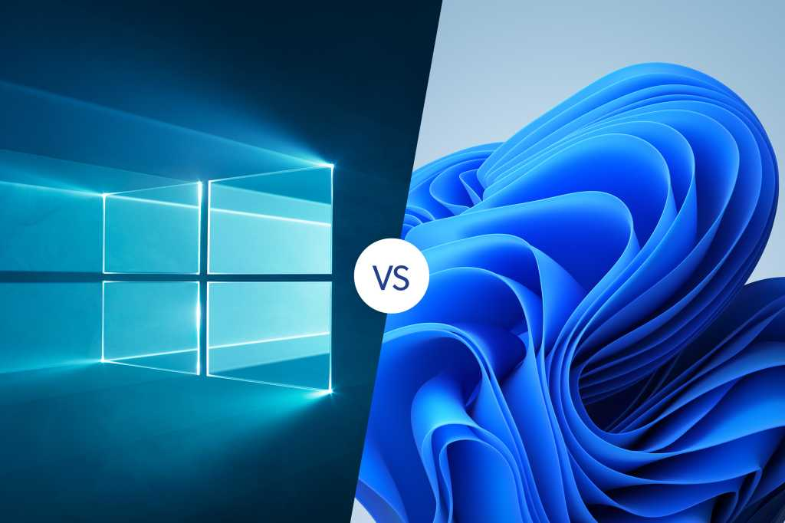
Updated version are even worse
Notes:
dd

